Slide 1
Compiler Design (22CS302) III B.Tech – I Semester
Department of Computer Science and Engineering

Slide 2
Compilers
Compiler is a program which takes one language (the source language) as input and translates it into an equivalent another language (the object or target language).
During this process of translation if some errors are encountered then compiler displays them as error messages. The basic model of compiler can be represented as follows.
Source
Program
Compiler
Target
Program
Error messages
Department of Computer Science and Engineering

Slide 3
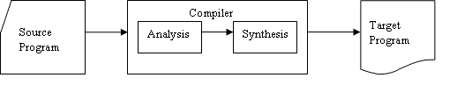
The Analysis-Synthesis Model of Compilation
There are two parts to compilation:
In analysis phase, an intermediate representation is created from the given source program.
Lexical Analyzer, Syntax Analyzer and Semantic Analyzer are the parts of this phase.
In synthesis phase, the equivalent target program is created from this intermediate representation.
Intermediate Code Generator, Code Generator, and Code Optimizer are the parts of this phase.
Department of Computer Science and Engineering

Slide 4
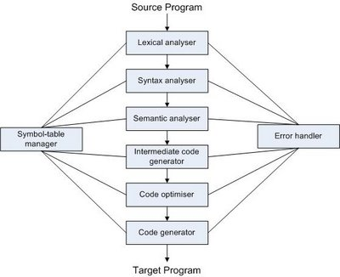
Phases of Compiler
Department of Computer Science and Engineering

Slide 5
Lexical Analyzer
Lexical Analyzer or Linear Analyzer breaks the sentence into tokens. For example following assignment statement :-
position = initial + rate * 60
Would be grouped into the following tokens:
1. The identifier position.
2. The assignment symbol =.
3. The identifier initial.
4. The plus sign.
5. The identifier rate.
6. The multiplication sign.
7. The number 60
Department of Computer Science and Engineering

Slide 6
Symbol Table
position | Id1 & attributes
initial | Id2 & attributes
rate | Id3 & attributes
An expression of the form :
position = initial+rate*60
gets converted to → id1 = id2 +id3*60
So the Lexical Analyzer symbols to an array of easy to use symbolic constants (TOKENS). Also, it removes spaces and other unnecessary things like comments etc.
Department of Computer Science and Engineering

Slide 7
Syntax Analysis
Syntax analysis is also called PARSING. It involves grouping the tokens of the source program into grammatical phrases that are used by the compiler to synthesize output. It checks the code syntax using CFG : i.e. the set of rules.
For example: if we have grammar of the form:
E→E = E | E + E | E * E | const | id
Then corresponding parse tree derivation is:
E→ E = E→id = E+E→id = id + E*E→id = id + id*60
Department of Computer Science and Engineering

Slide 8
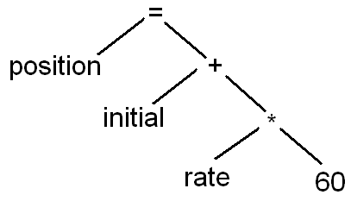
Syntax Analysis
Parser thus consumes these tokens. If any token is left unconsumed, the parser gives an error /warning.
Following is the parse tree for the taken equation:-
Department of Computer Science and Engineering

Slide 9
Semantic Analysis
The semantic analysis phase checks source program for semantic errors and gathers type information for the subsequent code-generation phase.
In this checks are performed to ensure that the components of a program fit together meaningfully.
For example:
int a; int b;
char c[ ];
a=b + c; (Type check is done)
Department of Computer Science and Engineering

Slide 10
Intermediate Code Generation
The intermediate representation as a program for an abstract machine.
For the example used in lexical analysis the intermediate representation will be:
temp1=inttoreal(60)
temp2= id3*temp1
temp3=id2+temp2
id1=temp3
Department of Computer Science and Engineering

Slide 11
Code Optimization
The code optimization phase attempts to improves the intermediate code, so that faster-running machine code result.
The final code for example above will be:-
temp1=id3*60 // removed unnecessary
id1=id2+temp1 //variables
In “optimizing compilers”, a significant amount of time is spent on this phase. How-ever, there are simple optimizations that significantly improve the running time of the target program with out slowing down the compilation too much.
Department of Computer Science and Engineering

Slide 12
Code Generation
The Final phase of the compiler is the generation of the target code, consisting normally of the relocatable machine code or assembly code.
Compilers may generate many types of target codes depending on M/C while some compilers make target code only for a specific M/C.
Translation of the taken code might become:
MOVF id3, R2
MULF #60.0, R2
MOVF id2, R1
ADDF R2, R1
MOVF R1, id1
Department of Computer Science and Engineering

Slide 13
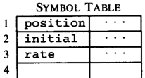




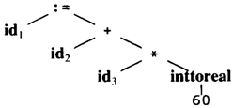
Phases Translation
Code Generator
[Intermediate Code Generator]
Non-optimized Intermediate Code
Scanner [Lexical Analyzer]
Tokens
Code Optimizer
Parser [Syntax Analyzer]
Optimized Intermediate Code
Parse tree
Code Generator
Target machine code
Semantic Process [Semantic analyzer]
Abstract Syntax Tree w/ Attributes
Department of Computer Science and Engineering

Slide 14
The Grouping of Phases
Compiler front and back ends:
Front end:
Analysis steps + Intermediate Code Generation
Depends primarily on the source language
Machine Independent
Back end:
Code optimization and generation
Independent of source language
Machine dependent
Department of Computer Science and Engineering

Slide 15
THANK YOU
Department of Computer Science and Engineering

